Slide 1


How to import bibliographic records
to a digital collection
Yoel Kortick
Senior Librarian
http://gwk.udk-berlin.de/wp-content/uploads/2012/11/TU-Universitaetsbibliothek.jpg

Slide 2


Introduction
The 787 field in the imported record
The import profile
Running the Import and Viewing Results
Summary
https://slidemodel.com/templates/animated-rainbow-business-powerpoint-template/
http://image.shutterstock.com/z/stock-photo-business-hand-writing-blank-agenda-list-130255148.jpg

Slide 3
Introduction
It is possible to associate bibliographic records with a collection during import.
This is done by using the normalization routine ‘Add Bib to Collection’ in conjunction with the 787 field.
See also the Alma On Line Help at https://knowledge.exlibrisgroup.com/Alma/Product_Documentation/Alma_Online_Help_(English)/Resource_Management/060Record_Import/020Managing_Import_Profiles

Slide 4
Introduction
The 787 field in the imported record
The import profile
Running the Import and Viewing Results
Summary
https://slidemodel.com/templates/animated-rainbow-business-powerpoint-template/
http://image.shutterstock.com/z/stock-photo-business-hand-writing-blank-agenda-list-130255148.jpg

Slide 5
The 787 field in the imported record
The 787 field in the imported record will need to contain information regarding with which collection the record should be associated.
Details may be found here:
https://knowledge.exlibrisgroup.com/Alma/Product_Documentation/Alma_Online_Help_(English)/Resource_Management/050Inventory/030Managing_Digital_Resources#Preparing_the_XML_Metadata_File

Slide 6
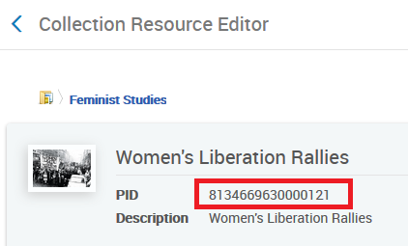
The 787 field in the imported record
For example, we will add our records to collection “Women's Liberation Rallies”.
It has PID 8134669630000121

Slide 7
The 787 field in the imported record
Therefore the records in our import file will have this field:
<datafield tag="787" ind1=" " ind2=" ">
<subfield code="w">8134669630000121</subfield> </datafield>

Slide 8
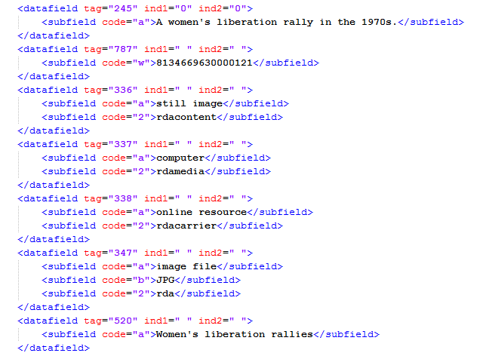
The 787 field in the imported record
For example:

Slide 9
Introduction
The 787 field in the imported record
The import profile
Running the Import and Viewing Results
Summary
https://slidemodel.com/templates/animated-rainbow-business-powerpoint-template/
http://image.shutterstock.com/z/stock-photo-business-hand-writing-blank-agenda-list-130255148.jpg

Slide 10
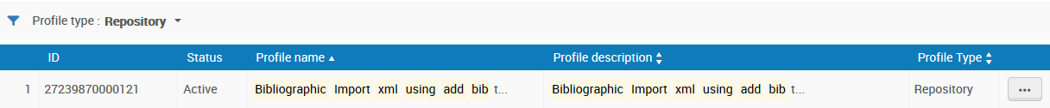
The import profile
Here is our import profile using the normalization routine ‘Add Bib to Collection’
This profile is of type ‘Repository’. Other profile types may also be used for this functionality.

Slide 11
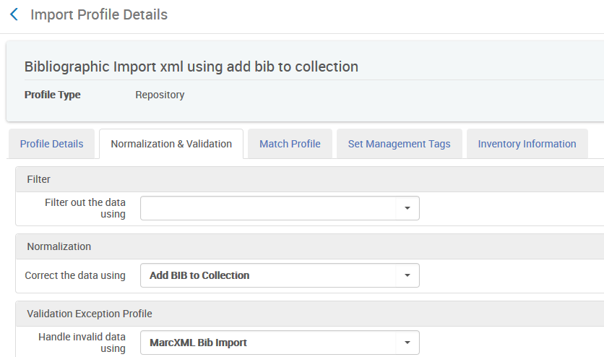
The import profile
The special routine telling Alma to use the 787 field for the collection

Slide 12
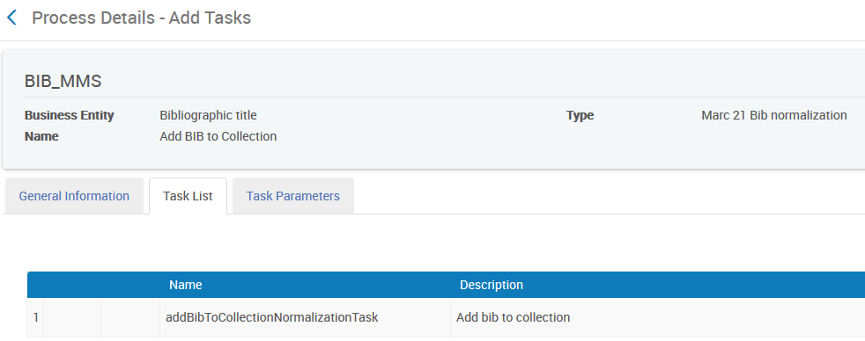
The import profile
The ‘Add BIB to Collection’ routine which is used in the import profile by default appears in the list of normalization process in the bibliographic profile.
It uses a task called addBibToCollectionNormalizationTask

Slide 13
Introduction
The 787 field in the imported record
The import profile
Running the Import and Viewing Results
Summary
https://slidemodel.com/templates/animated-rainbow-business-powerpoint-template/
http://image.shutterstock.com/z/stock-photo-business-hand-writing-blank-agenda-list-130255148.jpg

Slide 14
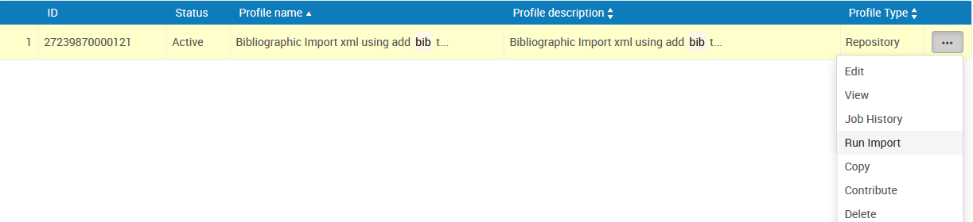
Running the Import and Viewing Results
Now we will run the import

Slide 15
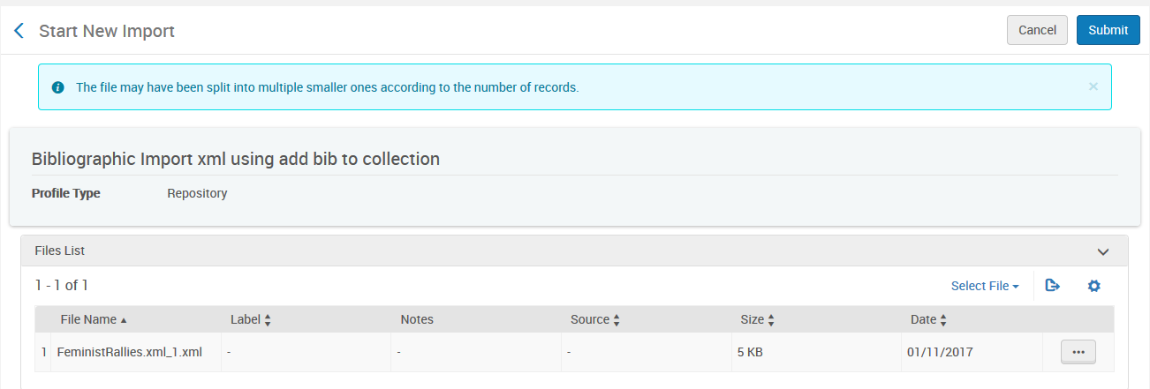
Running the Import and Viewing Results
We have chosen our file and will submit

Slide 16
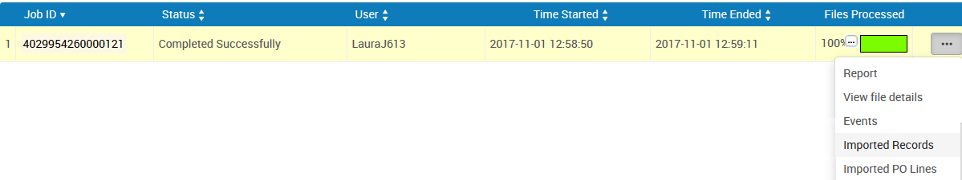
Running the Import and Viewing Results
Now we will view the imported records

Slide 17
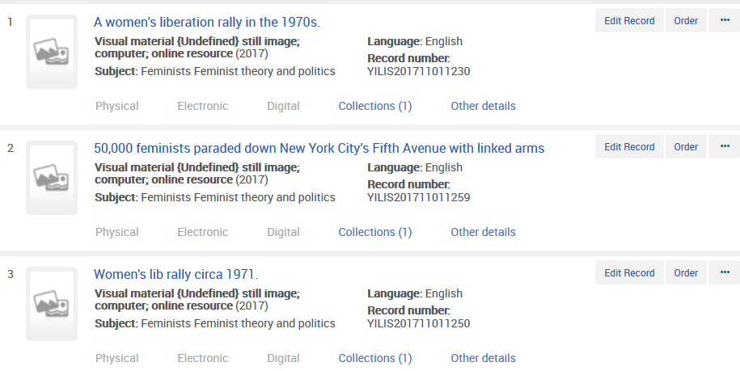
Running the Import and Viewing Results
They were all added to a collection

Slide 18
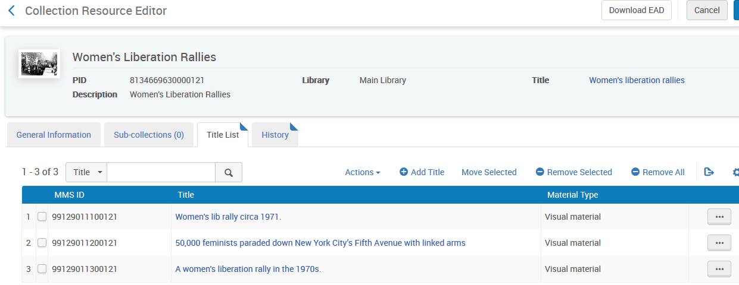
Running the Import and Viewing Results
They were added to collection “Women's Liberation Rallies” with PID 8134669630000121 as specified in the import profile

Slide 19
Thank you
Yoel Kortick
Senior Librarian
http://israelvalley.s3-eu-west-1.amazonaws.com/files/000/011/391/original/big-data.png?1406714586

